Slide 1
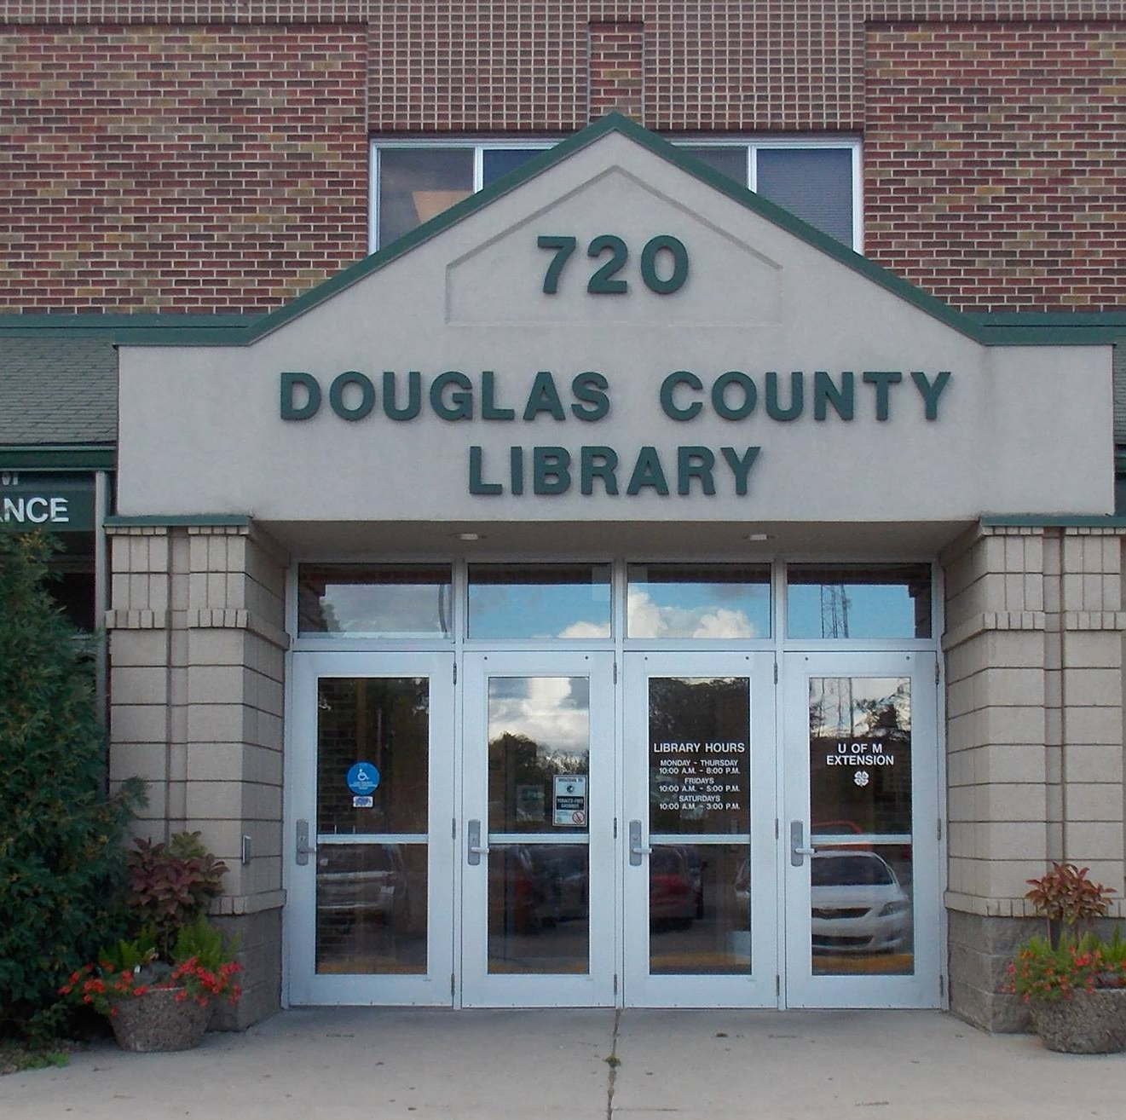

A New Chapter
Douglas County Library 2028

Slide 2







Libraries are essential.
  Outside of home and work, libraries are “third places” that anchor community life as part of our social infrastructure.
  Unlike many third places, libraries are free and accessible to all.
  Libraries are hubs for education and literacy, culture, workforce development, and community connection.

Slide 3
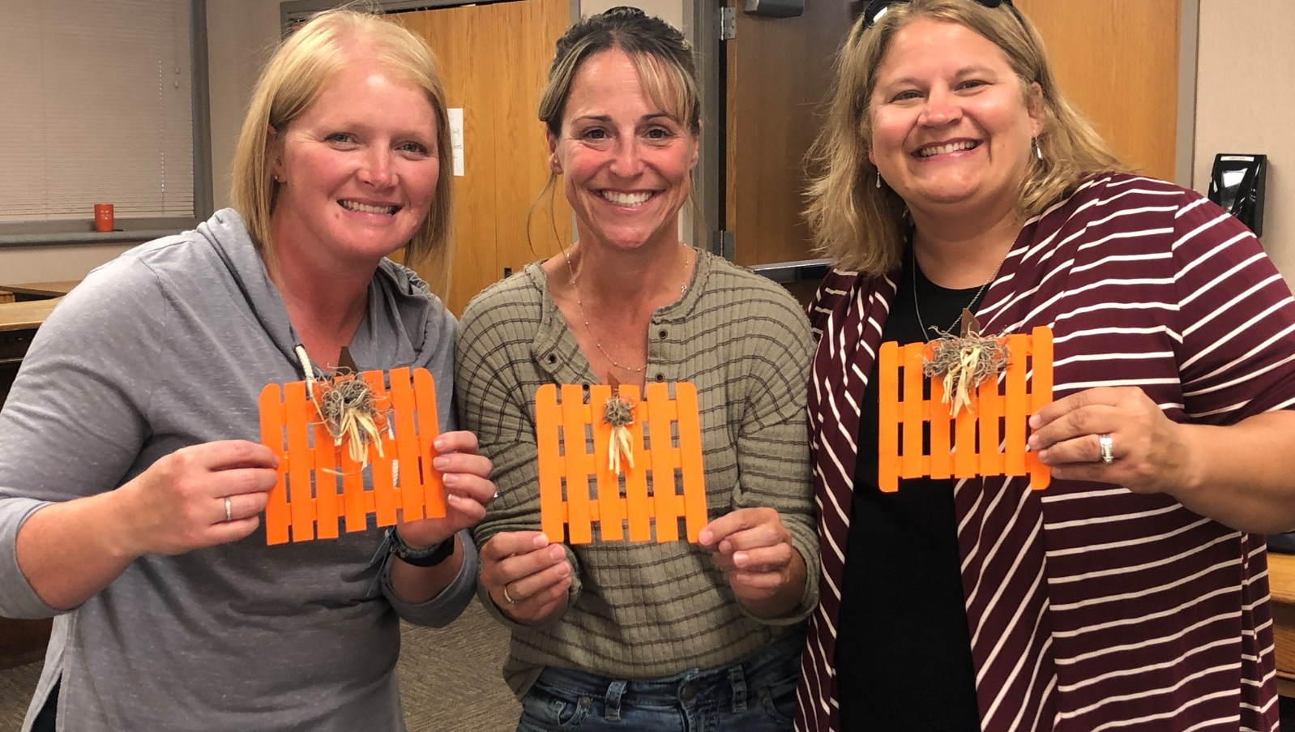
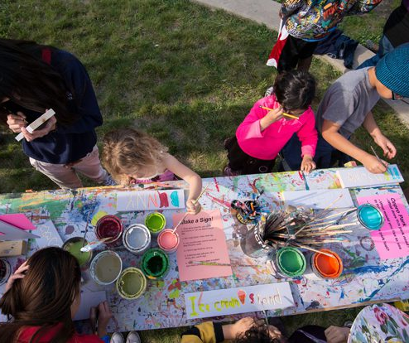
Residents rely on Douglas County Library.
"The staff at the library are always very helpful and friendly."
Patrons check out more than 336,000 materials per year on average.
Hundreds of programs serve an average of nearly 6,000 people each year.
Douglas County Library (DCL) sees more than 200,000 visits each year.
DCL is the only library serving residents of Alexandria, Brandon, Carlos, Evansville, Forada, Garfield, Holmes City, Kensington, Miltona, Nelson, Osakis, and other Douglas County communities.
"Every time we go it seems like new and creative items are added (like the adult activity bags – how neat is that!?)"

Slide 4
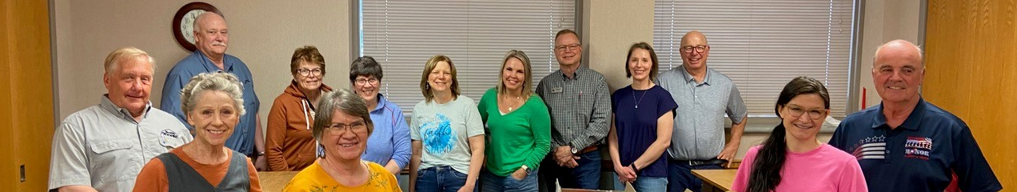
We listened to our community.
A 2021 Community Needs Assessment:
  engaged residents, including 599 survey respondents, 28 focus group participants, and 34 one-on-one interviewees
  included extensive research on current facility, industry standards, and peer libraries
Did you know?
Douglas County is among the 21 (of 87) counties in the State of Minnesota where residents are served by just one brick-and-mortar, full-service library facility. Within that subset, it is one of the largest counties by population.

Slide 5



The result: our building cannot meet community needs.
The library was moved to its current location 30 years ago in 1995.
The current space cannot hold the large collection, provide enough room for programs, or comfortably accommodate all patrons.
Douglas County is growing. More residents = more demand for services.
The landlocked building cannot effectively be expanded or renovated to meet the diverse and growing needs of our community.
Current Library:
19,900 SF
Recommended Library Size for DCL Population:
34,000 SF
"I think the library outgrew the space a very long time ago. Staff has done well getting as much in as possible, but there is no room for growth."

Slide 6
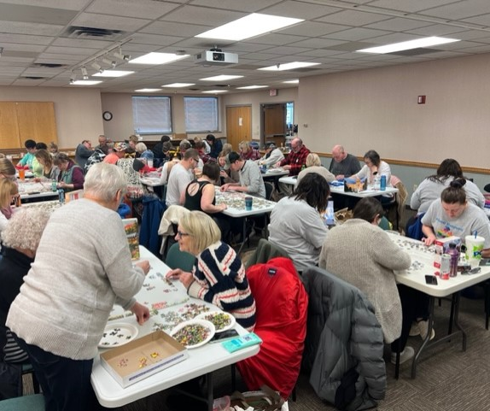
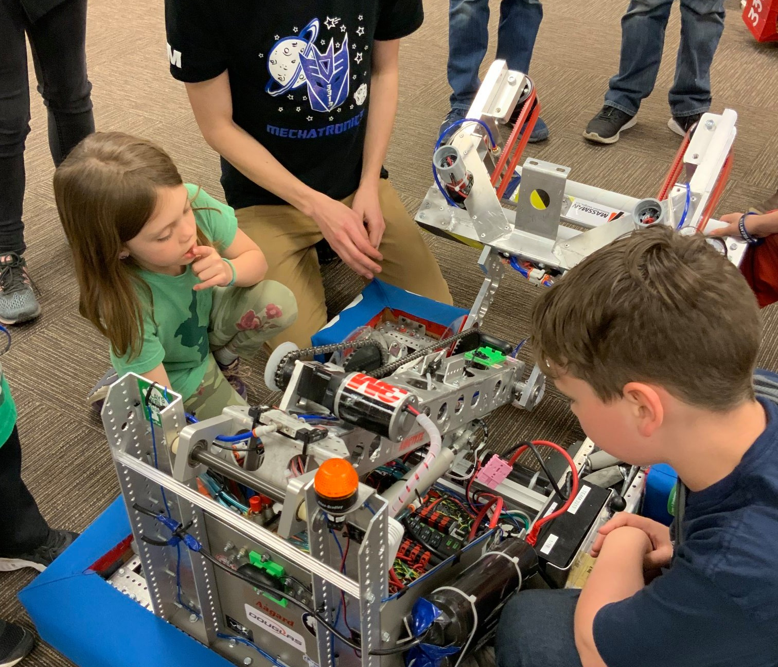
Our county needs a new library.
A new library will offer our residents better:
  Accessibility
    Visibility, ample parking, one-story space
  Flexibility
    Space for various programs, community meetings, quiet and loud activities
  Connection
    More opportunities for residents across county to connect to resources, information, and each other

Slide 7



With a new building, our Library can:
Partner with more community organizations to offer programming
Offer more flexible spaces for meeting, gathering, learning, and studying
Provide today's technology and plan for the technology of tomorrow
Respond to evolving community needs now, and in the future
In 2023 DCL offered
472 Programs
5982 Attendees
“The children's collection is amazing, and I know it could be even more amazing with more space and funding. It would be great if there could be more of a designated space for teens separate from the children's area, too. And a designated storytime area would be fun.”

Slide 8
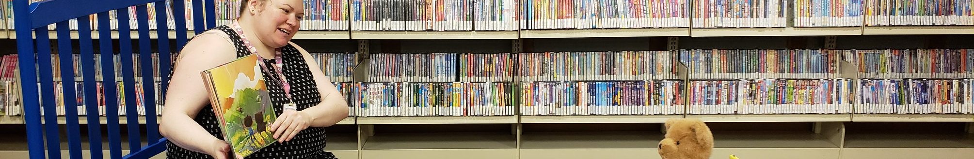
Overview of investment
Proposed Building: 34,000 SF
Construction Estimate: $15 - $17 million
Notes:
Construction estimate includes hard costs and contractor OHP, furniture, fixtures, and shelving, professional fees, contingency at 9% of project budget
Estimate assumes 4% inflation over 4.5 years
Construction begins spring of 2027
Land costs are not included
Staffing will need to increase by 1.5 FTE
Increase in annual operating costs

Slide 9
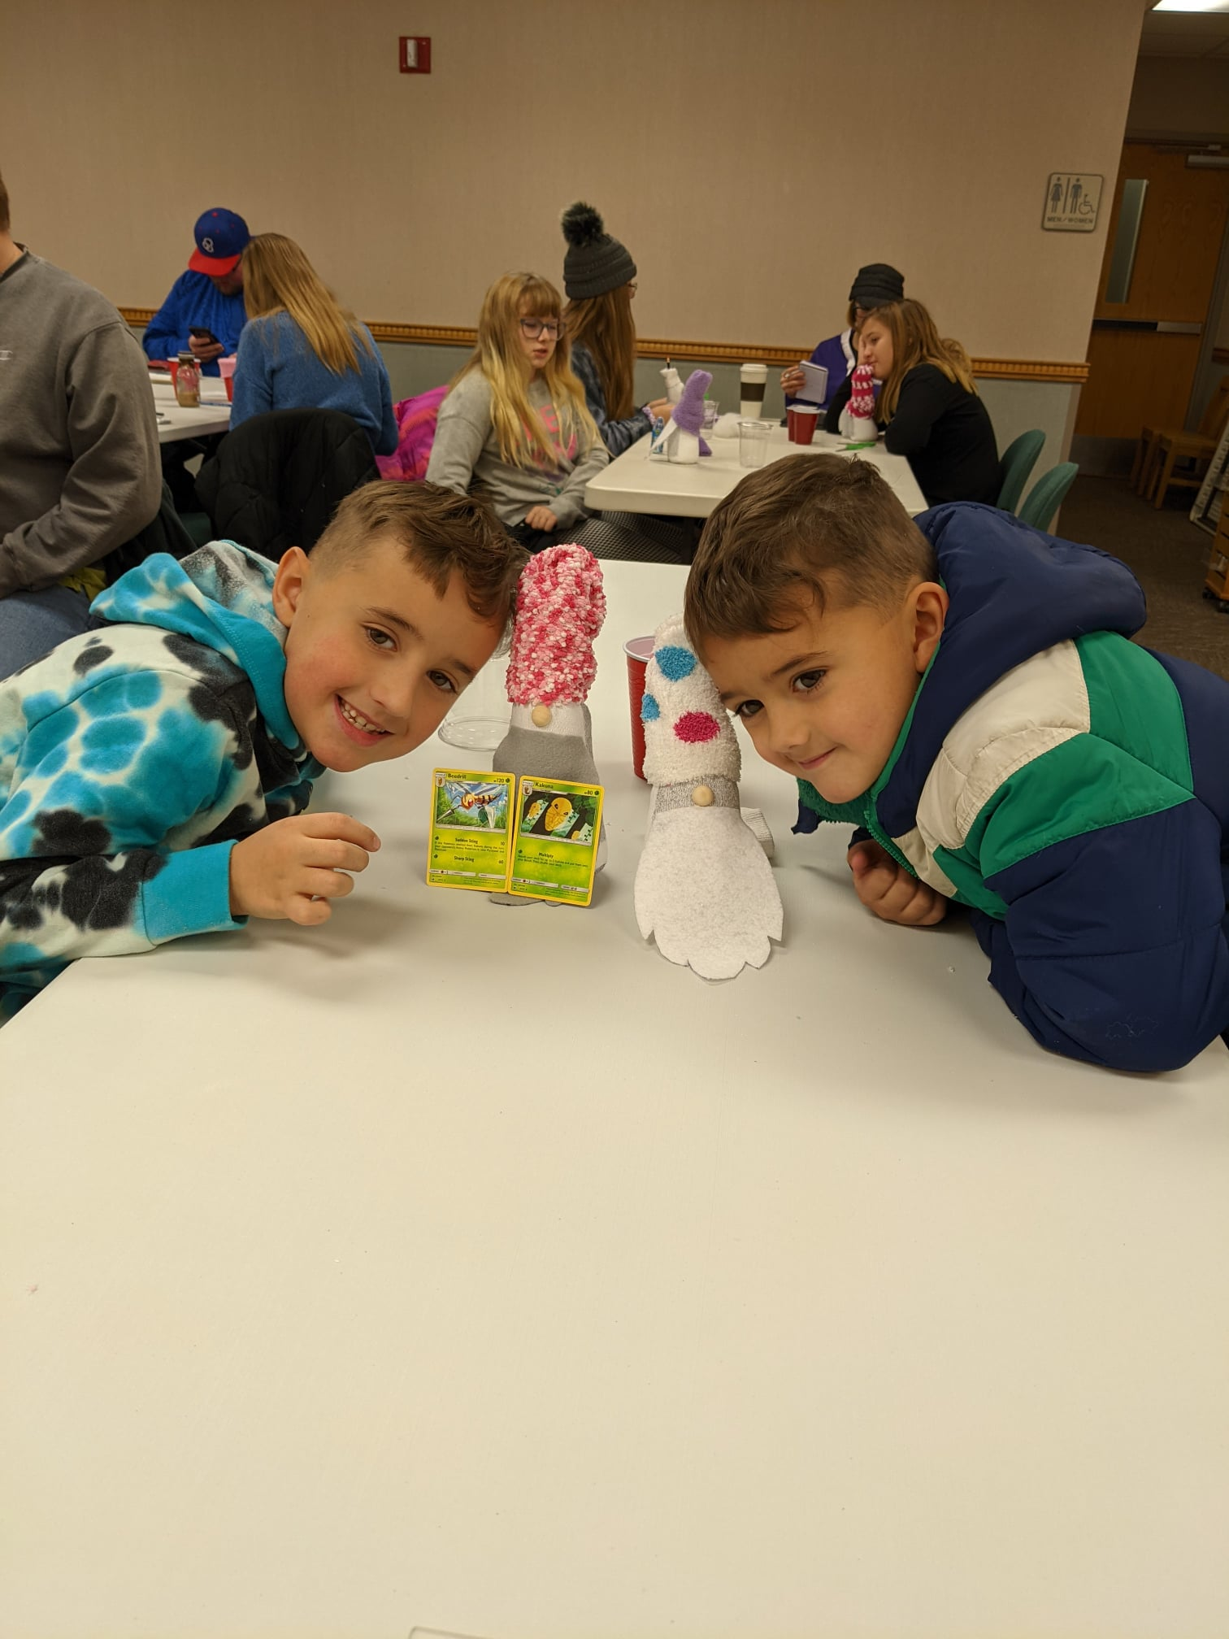
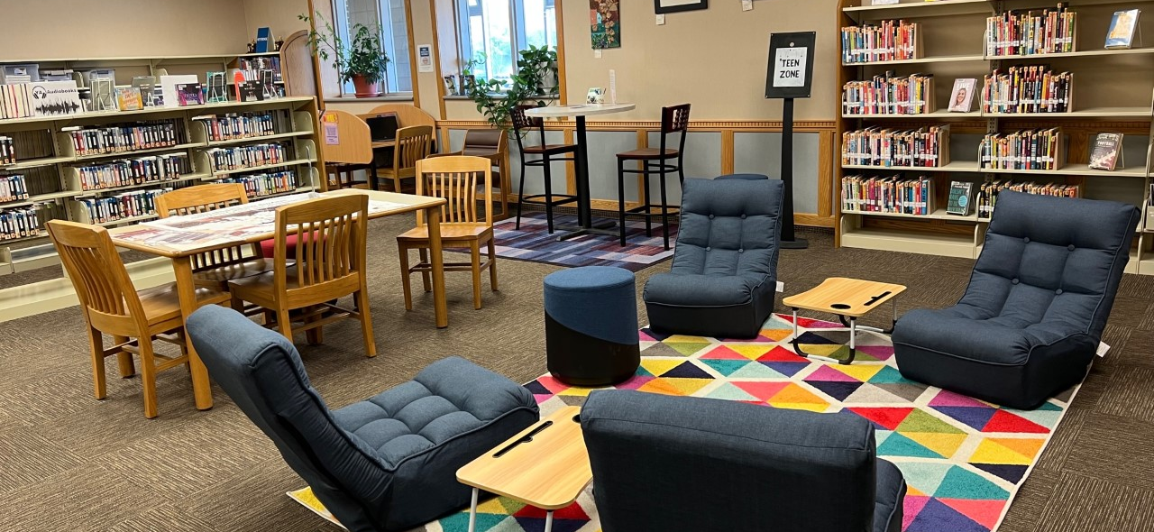
A new library is an investment in our future.
Our Library contributes to every aspect of quality of life in Douglas County.
With a new building, residents will have a welcoming space with more resources that can serve as a community hub for years to come.

Slide 10
New Chapter Timeline –
Where We Are
Community Needs Assessment:
    It was determined that Relocation was necessary to meet the needs of the growing community.
Steering Committee Formed
    Determined Criteria for Land
    Researched Funding Options
2023
2024
2021
2022
Site Selection Committee Formed
  Narrowed Possible Locations
  Received Gift of 10 Acres from Brent and Sally Smith.
    Old Jefferson High School Lot
  Organized a Community Task Force and Conceptual Design Team
Research of Current Facility
  Included weeding the collection, parking lot repair, expanding the Teen Area, and city signage

Slide 11

Next Steps
1.
Capital Campaign
2.
Explore supplementary funds such as grants
3.
Groundwork for voter referendum
4.
Construction
Next Opportunity 2026
2024-2025
2024 - Ongoing
2027-2028

Slide 12
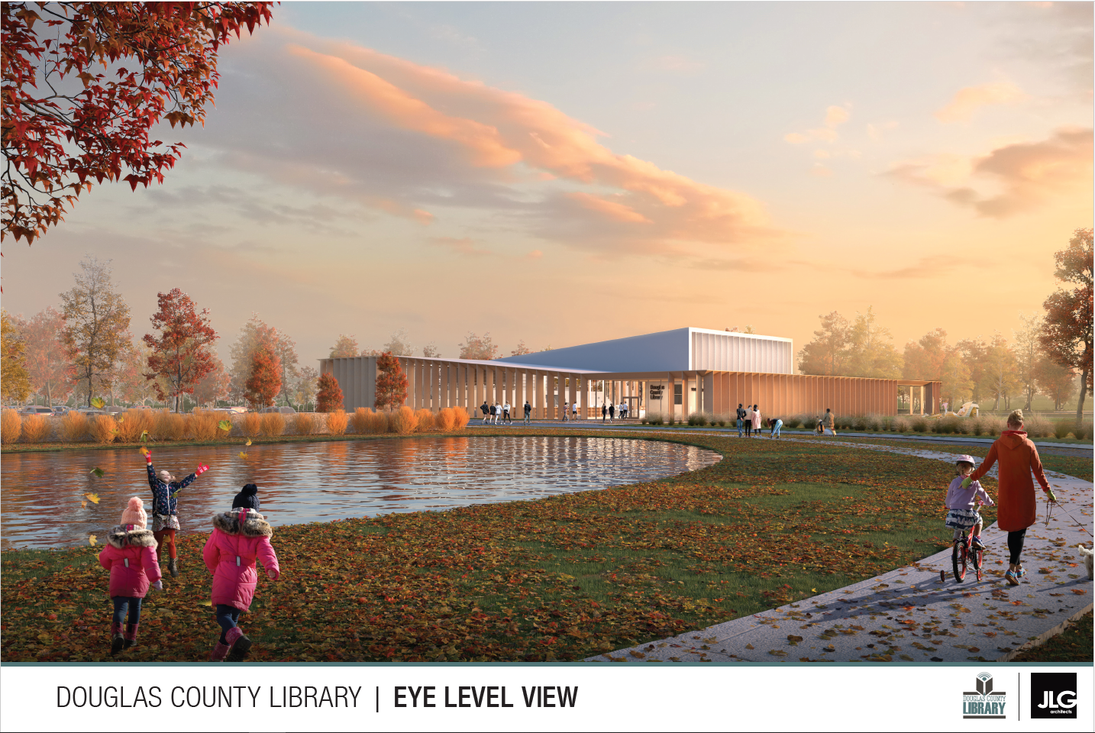
Goal
Doors Open in 2028!

